Slide 1

Metabolic Syndrome
Luz Dobbins

Slide 2
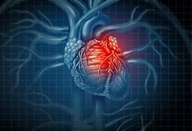
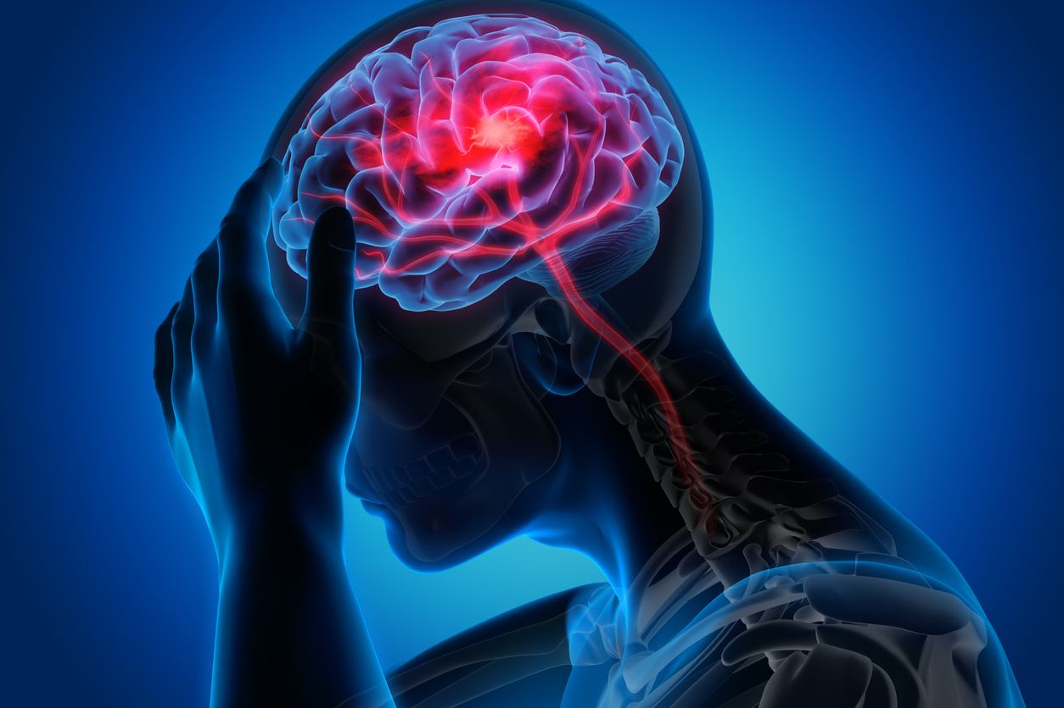
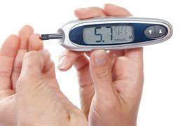
What is Metabolic Syndrome?
This is a cluster of conditions that can show a predisposition of diseases that can be managed but have not been cured, yet.
Diabetes
Heart Attack
Stroke
Notes:
Metabolic Syndrome is a cluster of conditions that have been known to be common precursers for conditions like Diabetes, heart attack, Stroke, hardening of arteries, cardiovarcular disease, kidney disease and fatty liver. Most of these wont show symptoms because there will always be outliers. This can be predicted by taking in a few factors. next

Slide 3

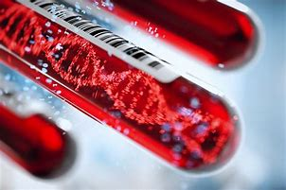
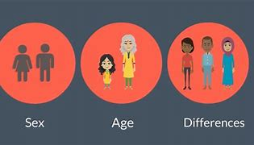
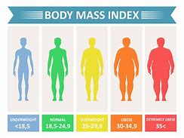
Factors
Some factors are things that you can see on social media: marital status, race, sex, age, and income.
It also has medical information like BMI, waist circumference, and blood work results testing like a Lipid profile test and a Blood Glucose test.
Notes:
These factors are things like race, sex, age, marital status and income. You also need some blood work and a physical, for the best diagnosis of these syndrome.
The information on this study was for 2,401 patients and includes up to 13 different factors for each person.

Slide 4
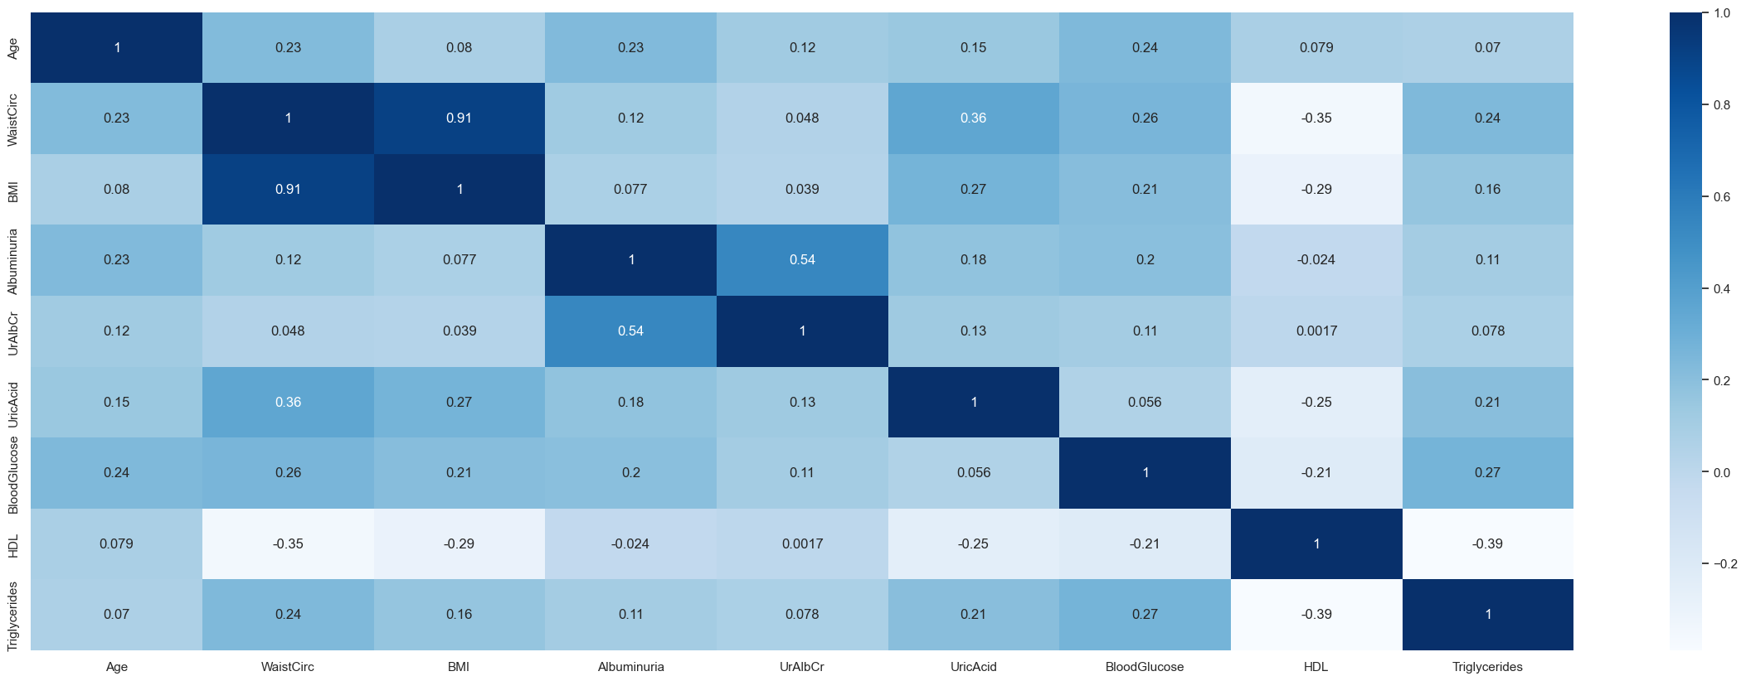
Correlation Map
Notes:
-HDL is High-density lipoprotein this is the good fat you want in your blood and take the bad LDL fat to the liver to break it down and be removed from the blood. You want this amount to be just right at 40–59 mg/dl. to little or to high will cause strokes, heart disease and diabetes. Which is why we are here.
-Blood Glucose is the amount of sugar in your blood. This is another amount that need to be in a range. For Blood Glucose this is 50 to 99 mg/dL and is the primary way patients are diagnosed with diabetes. A type 1 diabetic would have their own normal ranges, but insulin would be an everyday medication for them.
-BMI is the Body Mass Index which is the amount of fat you have in reference to weight and height. It is the quicks way to see if you are obese or skinny. Neither is great and we all deal with the social media images that don't help with our self image
-Triglycerides is a type of fat in your blood. If you have to much it will lead to heart disease.
-Albuminuria is having protein in your urine. This is an indicator of kidney disease, but could also point to an underlying cause, such as diabetes, high blood pressure, or cardiovascular (heart-related) disease. -----Not need for presentation(At lower levels, it's called microalbuminuria. At higher levels, it's known as albuminuria or proteinuria.)
-uralbcr is blood in urine. This could be a underlying health condition, kidney disease and infection
-uricacid is high uric acid levels which is a waste product found in blood that is filtered out by the kidney. This is another symptom that can lead to kidney disease, heart issues and stroke.
- All the items on the dataset are need to help identify predisposition of disease.

Slide 5
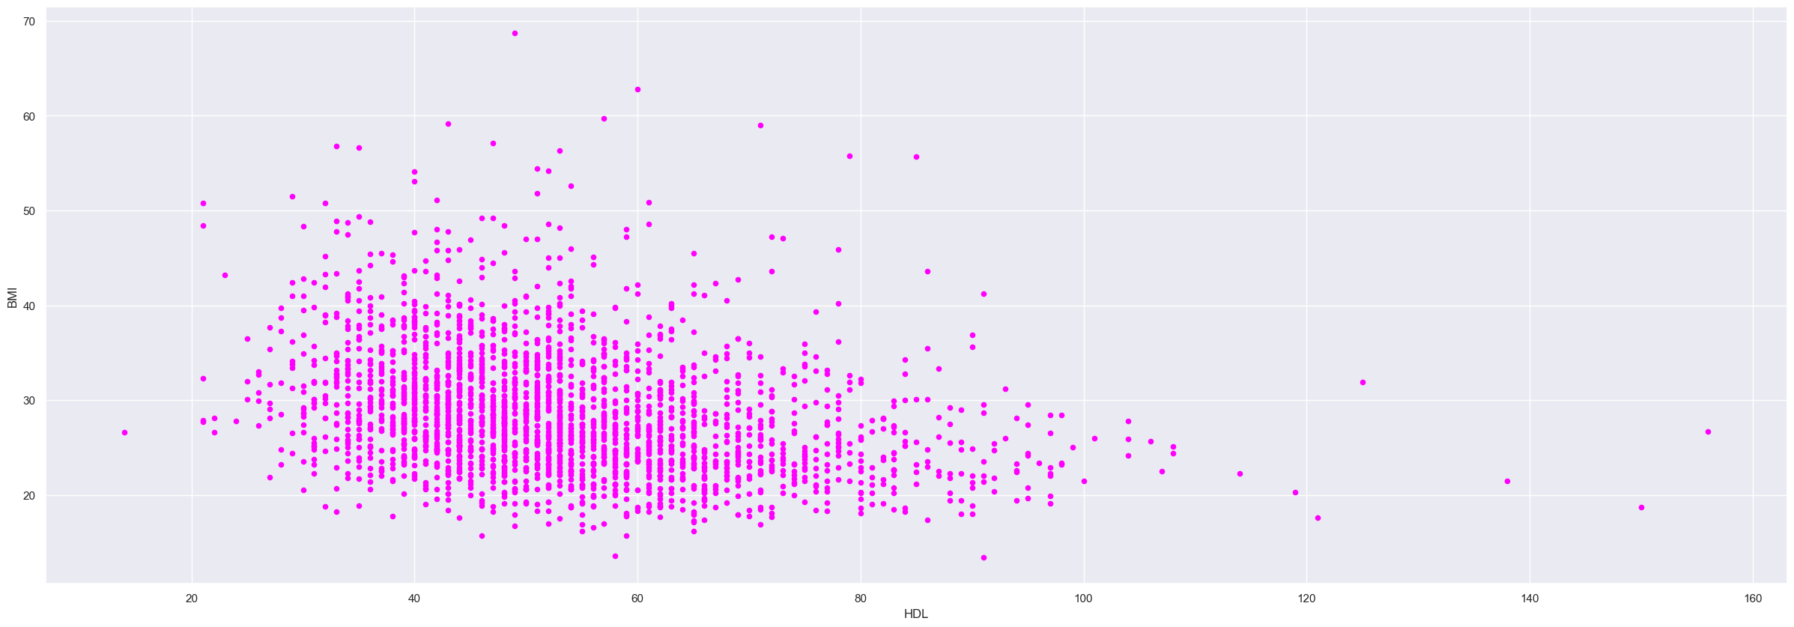
BMI and HDL
Notes:
I like this graft. It shows that people with higher BMI don’t necessarily have high HDL cholesterol levels. Any one can have high cholesterol and your Body Mass Index might not have anything to do with it. That is one of the reasons everyone should get annual checks to make sure we stay in a safe thresh hold. I can tell you have seen fit and athletic people have heart attacks and strokes, we are at risk and preventive medicine is the best course of action.

Slide 6
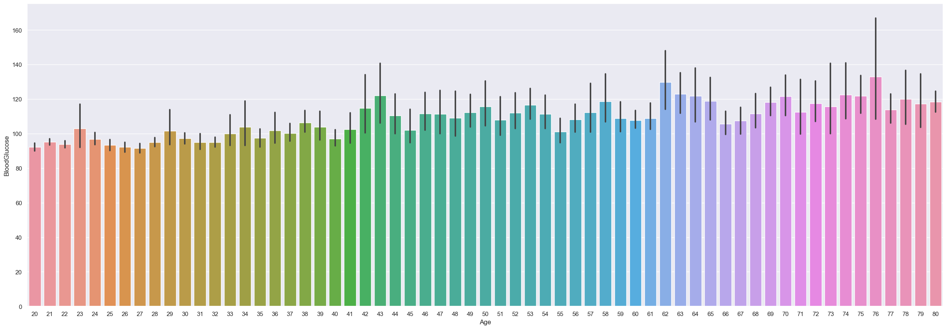
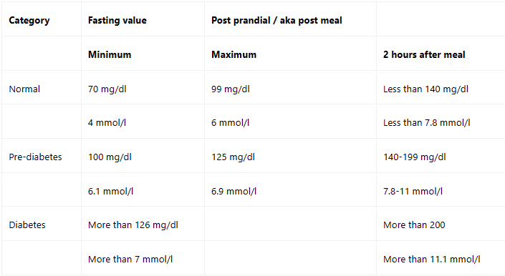
Blood Glucose by patient's age
Notes:
This graft shows the average blood glucose by age of the patients. You can see more out liers in the older individuals but there are still a few on their 20’s. Like everything else in this presentation. All this conditions can lead to other issues in people lives. I have included the chart of Blood Glucose levels and what they mean.

Slide 7

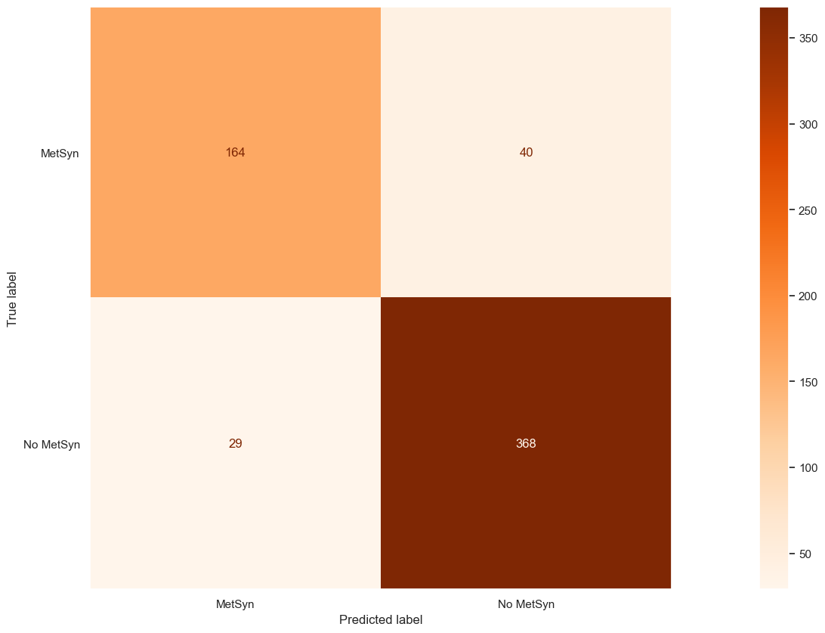
XGBoost Classifier
The best model for this project was the eXtreme Gradient Boosting.
88% accuracy score
Confusion Matrix shows the best presentation of this dataset.
Notes:
The extreme gradient Boosting classifier was the best out of the group. It gave the best accuracy store of 88% and the confusion matrix presented is with some tuning the best I found.

Slide 8
- This data will be essential to help doctors with diagnosis their patient with preventative care. - This project will help reduce the amount of money hospitals use for patients that don’t have insurance but need urgent care/surgeries. - This data can lead to a reduction in strain for preventable medical conditions. - We are here for patients, but they are not the only a part of the picture. Family, friends and colleagues are also part of our patients care and life. With that being said….
Notes:
- This data will be essential to help doctors with diagnosis their patient with preventative care. - This project will help reduce the amount of money hospitals use for patients that don’t have insurance but need urgent care/surgeries. - This data can lead to a reduction in strain for preventable medical conditions. - We are here for patients, but they are not the only a part of the picture. Family, friends and colleagues are also part of our patients care and life. With that being said….

Slide 9

The way to get started is to quit talking and begin doing.
Walt Disney
Notes:
This!

Slide 10


Thank You
Notes:
The end

